Slide 1



Tobacco Cessation Behavioral Health Program
Tailored Support for Participants with Behavioral Health Conditions
Notes:
Introducing the Tobacco Cessation Behavioral Health Program for Tobacco Free Florida.

Slide 2
Tailored Support for Participants with Behavioral Health Conditions
Clinical and Innovation Team
Robert Vargas, MSW, MPH
Director - Clinical Development and Treatment Support, Optum Healthcare
Robert.Vargas@Optum.com
Etta Short, MS
Director – Clinical Development and Implementation, Optum Healthcare
Etta.Short@Optum.com

Slide 3
Overview
Why build a tobacco cessation behavioral health program?
What are the features of the program?
How were Coaches trained?
What were the outcomes of the pilot?
Notes:
We will consider practices that contribute to a difficult session: content, process and perceptual factors.
We will explore common mental illnesses and their unique challenges. You should be aware of how these common mental health conditions may impact the client’s quit process. This training will also cover some basic strategies you can use with this population.
Having a better understanding of the client’s situation will help you to make basic changes to your style so that you are talking about useful content in a way that makes sense to the client (process) without letting your perceptions interfere.
Please note: this is not training on diagnosing clients, recommending treatment on mental health conditions, or becoming experts on common mental illnesses.
One of the first steps towards providing better service to clients with mental illness is becoming aware of your own perceptions of this population.
Write down one or two thoughts that cross your mind when you are conducting an intervention and someone reports struggling with mental illness.

Slide 4
Strategies
Content
Process
Intervention
Notes:
We will consider practices that contribute to a difficult session: content, process and perceptual factors.
We will explore common mental illnesses and their unique challenges. You should be aware of how these common mental health conditions may impact the client’s quit process. This training will also cover some basic strategies you can use with this population.
Having a better understanding of the client’s situation will help you to make basic changes to your style so that you are talking about useful content in a way that makes sense to the client (process) without letting your perceptions interfere.
Please note: this is not training on diagnosing clients, recommending treatment on mental health conditions, or becoming experts on common mental illnesses.
One of the first steps towards providing better service to clients with mental illness is becoming aware of your own perceptions of this population.
Write down one or two thoughts that cross your mind when you are conducting an intervention and someone reports struggling with mental illness.

Slide 5
Strategies
Content
Perception
Process
Intervention
What are your thoughts?
Notes:
We will consider practices that contribute to a difficult session: content, process and perceptual factors.
We will explore common mental illnesses and their unique challenges. You should be aware of how these common mental health conditions may impact the client’s quit process. This training will also cover some basic strategies you can use with this population.
Having a better understanding of the client’s situation will help you to make basic changes to your style so that you are talking about useful content in a way that makes sense to the client (process) without letting your perceptions interfere.
Please note: this is not training on diagnosing clients, recommending treatment on mental health conditions, or becoming experts on common mental illnesses.
One of the first steps towards providing better service to clients with mental illness is becoming aware of your own perceptions of this population.
Write down one or two thoughts that cross your mind when you are conducting an intervention and someone reports struggling with mental illness.

Slide 6
Background
Justification for a Specialized Treatment
Notes:
Now that we are aware of our own perceptions in working with this population, let take some time to talk about why a program like this is needed.

Slide 7
Current Smoking Among Adults With Past Year Behavioral Health Condition (BHC): NSDUH, 2008-2015
(Data Produced by SAMHSA)
Current Smoking is defined as any cigarette use in the last 30 days prior to the interview date.
Behavioral Health Condition includes Any Mental Illness and or Substance Use Disorder
*Due to changes in survey questions regarding substance use disorder in 2015, including new question on meth and prescription psychotherapeutics, this data is not comparable to prior years.
Notes:
Slide to describe the rates of smoking are decreasing, however, specific populations are still being disproportionately affected by smoking.
Smoking Prevalence among those who have a mental health condition is 34%.
Anxiety ~54%
Depression ~44%
PTSD ~45%
ADHD ~42%
OUD ~90%
SUD ~68%
From Lasser et al., 2000 and Ziedonis et al, 2008
There are 540,000 tobacco related deaths per year in the US.
Roughly 240,000 of those death are people with co-occuring behavioral health conditions.
Almost as many death annually attributed to: Carter et al, NEJM Feb 2015
Obesity
Suicide
Motor Vehicle Accidents
Alcohol
Homicide
AIDS/HIV

Slide 8
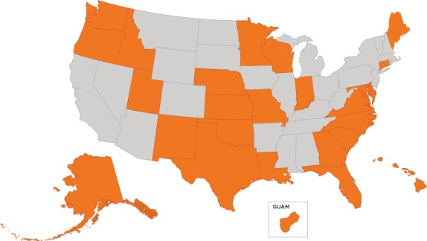
Why Quitines?
Currently we operate 26 state Quitlines
In partnership with
American Cancer Society®
30+
years providing
behavior change
Alaska, Connecticut, Washington DC, Delaware, Florida, Georgia, Guam, Hawaii, Idaho, Indiana, Kansas, Louisiana, Maine, Maryland, Minnesota, Missouri, New Mexico, North Carolina, Nebraska, Oklahoma, Oregon, South Carolina, Texas, Virginia, Washington, Wisconsin, Utah.
Notes:
We have the ability to reach millions of people throughout the United States

Slide 9
Participants who Report Mental Health Conditions Use of State Quitlines
Vickerman et al. (2015)
% Quitline Callers who report 1 MHC
% of MHC Quitline Callers who report 2 or more conditions
*Prevalence Rate Data from 3 State Quitlines (n= 3,262)
Notes:
More so, People with Mental Health Conditions are already calling the Quitlines
Currently 34% Prevalence Rate of Tobacco Use with those who report a Mental Health Condition (MHC)
Upward of 60% prevalence rate depending on condition
Of those who call Quitlines, 45.8% report at least 1 MHC
Of those reporting a MHC, 57.2% report 2 or more co-occurring MHCs.

Slide 10
Quit Rates of Participants with Mental Health Conditions Use of State Quitlines
Vickerman et al. (2015)
Notes:
With MHC 22% (95% CI 19.5%-24.5%) vs Non-MHC 31% (95% CI 28.4%33.6%)
OR = .63 (95% CI .51-.77)
30 days without even a puff
7 month Follow-Up Data from State Quit Line

Slide 11
National Goal - National Behavioral Health Summit for Tobacco-Free Recovery
30x20
Notes:
2016
Participating Member of the National Behavioral Health Summit for Tobacco-Free Recovery
Joint summit with SCLC and ACS
Supporting National Goal: 30 by 20
Quitlines can and should be a cornerstone to any effective plan to reduce smoking prevalence in this population.

Slide 12
Program Design & Development
Tobacco Cessation Behavioral Health Program

Slide 13
Development Timeline
Q4 2015 Q2 2016
Research and Develop Pilot
Q3/Q4 2016
Launch Pilot
Q1/Q2 2017
Bring to Market
Evaluate
Q4 2016 Q1 2017
Notes:
Q4 2015
Began Lit Search and collaborating with specialist in the treatment communities.
Once we developed clinical recommendations, we began developing the program.
Q3 2016
We launched the proof of concept pilot program as an additional offering within the Texas State quitline
Completed Enrollments in Oct of 2016
Q4 2016
Began our EOP Surveys
Began Analyzing the data
Q1 2017
We are not in talked with additional states to offer this program within their own state quitlines.

Slide 14
Tobacco Cessation Behavioral Health Program
Notes:
This is what the program looks like when added to our standard program elements. This image shows us the incorporates elements of our technology suit, such as web coach and text to quit.
I however, do want to briefly touch base on specific differences between this new program and our standard of care.

Slide 15

Specific Program Features
Triaged
Enrollment
Process
Dedicated
Quit Coach
Team
Additional
Calls
Provider
Letter
12-Weeks
Combination
NRT
Enhanced
Assessment
Notes:
Triaged Enrollment Process
Used NAQC to assess for Mental Health Condition
Tier 1 Conditions: Bipolar/Schizophrenia
Tier 2 Conditions: Depression, Anxiety, PTSD, ADHD, and Substance Use Disorder.
Stress Interference Question
“Do you believe your condition will interfere with you ability to quit using tobacco?”
Additional Calls
We added an additional 2 calls per enrollment.
We evidence supported that this group might require additional support.
Combination NRT
Evidence suggested that this group could use additional NRT support to be more successful.
Conversations with treatment experts confirmed this decision.
Provided 12 weeks of Combination NRT
Patch +Gum
Patch +Loz
Coaches also provided decision support if the participant choose to use Bupropion or Chantix, and referred to them to their health care provider.
We wanted to focus on options available through the quitlines options.
Provider Letter
We created a letter to be sent to the participants Mental Healthcare Provider.
This letter focused on informing the MHP about the participants enrollment into the program.
Tips on how to support their client.
And they could call the quitline with questions that could be answered by our clinical team.
This letter was intended to act as a catalyst between the provider and the participant for them to engage in supportive conversations around their quitting process.
Enhanced Assessment
We added elements of to support assessment around stress management
Dedicated Team of Quit Coaches
Support Treatment Continuity
Enhanced Training – Handing it over to Etta

Slide 16
Enhanced Training for Coaches

Slide 17
Enhanced Training for Coaches
Rationale
Logistics
Skill Building
Confidence
Notes:
Rationale: Why this program is important
Structure: eligibility requirements, registration process, timeline , number of calls
Strategy: Logistics - How the program is designed to support participants with mental health conditions: more calls, team approach, contact with HCP and how it is different from a standard intervention. And emphasizing that there may be no difference between callers enrolled in this program and the standard Demonstrate adapting Content and facilitation when appropriate for ESP participants
Build your confidence working with participants with mental health conditions
The training was designed to prepare the Research Implementation Coach team for delivering the pilot by providing or reinforce knowledge and skills needed to execute the program. The training included:
Background of the pilot, rationale for pilot and tobacco use prevalence.
so that they had a full understanding of why the program was relevant and important.
Program logistics and the differences between the TC BHP and standard program
so the Coach can deliver the program design and features
Skill building to recognize behavior patterns related to specific behavioral health conditions and strategies for altering content and facilitation.
so that the Coach can tailor the intervention and build an effective therapeutic alliance.
Opportunities to practice to build confidence in working with this population.

Slide 18
Methods
Discussion
Knowledge
Call samples
Modeling
Case studies
Critical thinking
Practice
Role pay
Notes:
The training was designed using the model preparation, presentation, practice and feedback.
Preparation – increased engagement and level set the knowledge base
Presentation – content needed to build knowledge about the topic
Practice – hands on practice to apply knowledge and build skills
Feedback - an activity to demonstrate knowledge and skills gained.
Methods included discussion, presentation, listening to call samples, case study studies, fishbowls -- group role plays and individual role plays.
Coach skill was assessed by evaluation of calls with participants by Supervisors and program developers.

Slide 19
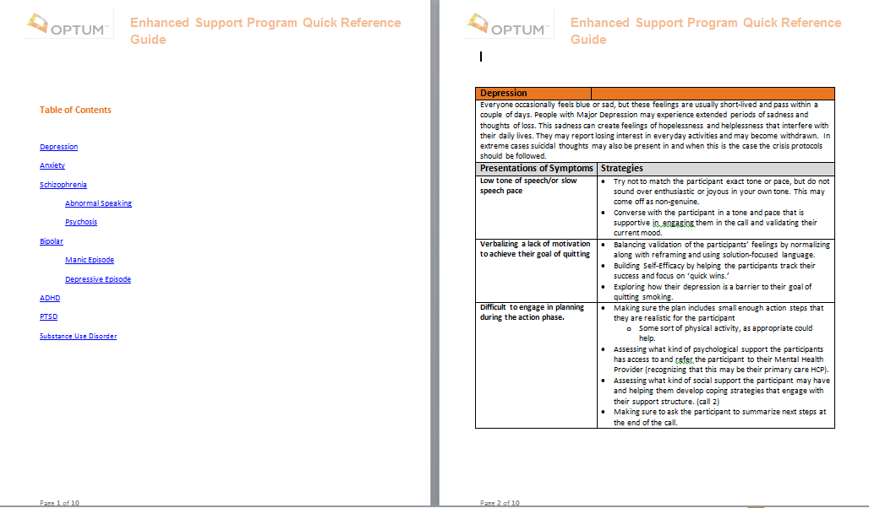
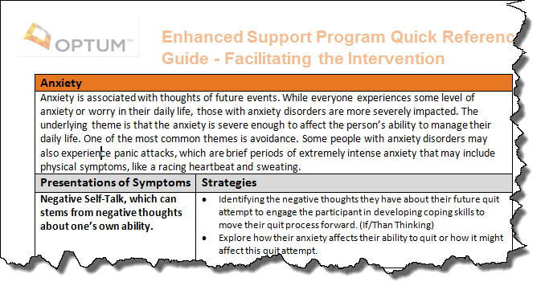
Quick Reference Guide
Notes:
Main point:
Coaches were given training aids to provide guidance for the facilitation and content of the calls.
There was a quick reference guide that focused on the various conditions – how they present and intervention strategies. This was useful during training and when the coaches were building skills in the early phases of the pilot.

Slide 20
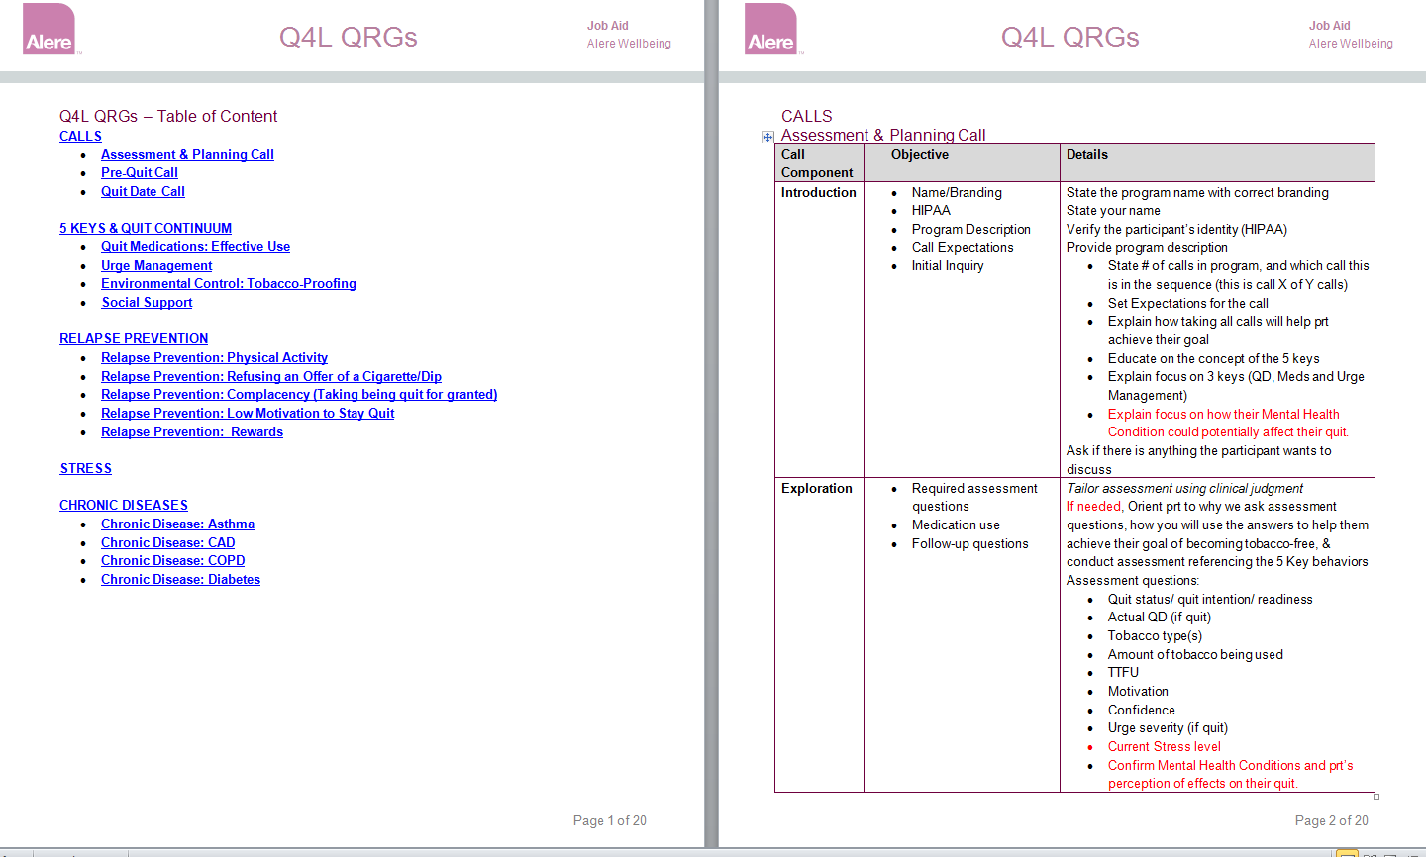
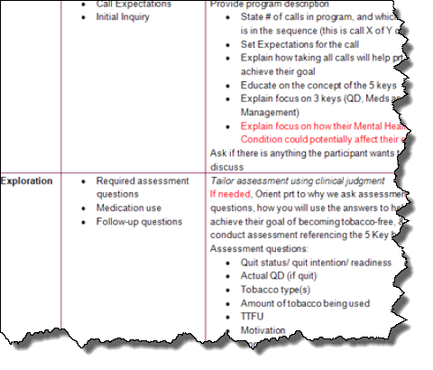
Quick Reference Guide
Notes:
Main point:
This guide focuses on the 5 phases of a call and how to adapt for this program.
This guide was also designed to support training and for the early phases of the pilot.
*This is for demonstration – do not elaborate – discussion of content to follow

Slide 21
Depression
How you would adapt your communication style and/or intervention content:
Q: A participant who presents with low motivation, talks slow, appears somewhat disengaged?
Example of Responses:
“I would adapt my pace to meet that of the prt. I would try asking open ended questions encouraging the prt to describe why motivation is low. Then I may work on helping the prt identify small steps to take to build motivation and/or confidence, such as mini quits.”
“Slow down myself, explore what motivated the call. Give them a little more time express their feelings. Might have look at less ambitious goals than in a normal call. Try assess what is realistic and attainable for them and focus on that.”
Notes:
Slide is animated
Note* I set this up to introduce the topic by reviewing the related pre-assessment question
“The first topic is depression. During the pre-assessment you responded to the question that is an example of how major depression presents.
– A participant who presents with low motivation, talks slow and appears somewhat disengaged.
What you may observe with these participants:
Low tone of speech/or slow speech pace
Verbalizing a lack of motivation to achieve their goal of quitting
Difficult to engage in planning during the action phase.”
Click to show sample responses: and use these responses to elaborate on strategies
Then review strategies for managing – Use QRGs for a screen visual.
Summarize – rather than elaborate on items.
We will follow up – reinforce after the role play.

Slide 22
Anxiety
How you would adapt your communication style and/or intervention content:
Q: A participant who presents with rapid speech, high levels of stress, low confidence and high level of worry about the quitting process
Examples of response:
“In this case it is important to set a QD with the participant that is realistic, giving time for preparation and mini quits to build confidence slowly. It is also important to figure out the participant’s thoughts and behaviors about smoking when stressed, and then strive to work with the prt on thought change and coping skills to experiment with in small steps.”
“I would normalize quitting concerns and try to make action plan tailored or manageable for the participant to build confidence.”
Notes:
During the pre-assessment you responded to the question that is an example of how major depression presents.
– A participant who presents rapid speech, high levels of stress, low confidence and high level of worry about the quitting process
What you may observe with these participants:
Negative Self-Talk, which can stems from negative thoughts about one’s own ability.
Avoidant speech patterns or difficult to engage or unwilling to share the conversation with the coach.
Low confidence in their ability to accomplish their goal of quitting.

Slide 23
Schizophrenia/Psychosis
How you would adapt your communication style and/or intervention content:
Q: A participant, who is hard to track, responds with odd statements and appears to ramble on various topics other than quitting smoking.
Example of Responses:
“I would overtly sign-post with the participant throughout the conversation to redirect and get back on topic. I would also gently suggest that writing down information can be helpful and flex my communication style by limiting talking points to ensure the most essential information is being presented for the participant to take away for their current plan.”
” Lots of sign-posting. Overt statements and yes/no questions. Keeping the call very straightforward and trying to identify one or maybe two very specific things that the prt could work on between this call and the next.”
Notes:
Use similar strategy,
Introduce topic using assessment question.
Review that the prt will present with:
Schizophrenia – Abnormal Speech
Inappropriate or bizarre speech
Nonsensical way of speaking, that may present itself as jumping around or disorganized speech.
Difficulty focusing or concentrating on the topic on the topic at hand.
Psychosis
False Beliefs

Slide 24
Preliminary Outcome Date
As of March 6, 2017

Slide 25
Outcome Goals
Acceptance
Engagement
Quit Outcomes
Notes:
Three Success Outcomes
Acceptance Rates
IF we offer the program will participants choose this additional services?
Engagement Outcomes
Can we improve the engagement rates within this population?
Quit Outcomes
Can we improve the quit outcomes from this population?

Slide 26
Acceptance Rates
Notes:
310 Enrolled Participants
275 active participants
Tier 1 Conditions vs Tier 2 Conditions
66% (205) participants reported a Tier 1 Mental Health Conditions
34% (105) participants reported a Tier 2 Mental Health Conditions
The following slide is based on End of Program Surveys that were conducted at 3 months post enrollment date
Response rate of EOP surveys is 37%

Slide 27
Engagement Outcomes
Avg. Completed Calls per Enrollment
Notes:
With a data pull of all participants enrolled in the program we saw engagement rates go up to 3.5 for this program.
The other charts are from EOP responses.
What was your experience with the number of completed calls?
63% (38) reported the number of calls they completed was just right.
This group averaged 5.2 completed calls.
31% (20) reported the number of calls they completed was too few.
This group averaged 5.5 completed calls.
6% (3) reported the number of calls they completed was too many.
This group average 2.45 completed calls.

Slide 28
Preliminary Outcomes – NRT Support
Prts who were dosed for Combination NRT
Of those Prts who were dosed for combination NRT – Dosed for Patch plus Lozenges
Notes:
What is the story – what is important about this
99% of Prts were dosed for NRT
100% of Tier 1 Prts
97% of Tier 2 Prts
92% of participants asked confirmed using NRT
53% of Prt received all 3 shipments
59% Tier 1
41% Tier 2
75% were dosed for Combination NRT
71% were dosed for Patch + Loz
29% were dosed for Patch + Gum

Slide 29
Preliminary Outcomes – Provider Letter
Prts who reported have a Mental Health Provider
Prts who spoke with their provider since enrollment
Prts who spoke to their provider about quitting
Notes:
Tier 1 Reporting a Provider 59% (118)
Tier 2 Reporting a Provider 36% (38)
55% (33) reported speaking with their Mental Health Provider once enrolling in Quitline Services 82% of those participants reported talking to their Mental Health Provider about their quit attempt

Slide 30
Quit Outcomes
30 Day Prevalence Quit Rates
Notes:
We were able to increase quit rates among this group to 37%. Compared to previous data showing quit rates among all prts with MHCs of 22%.
33% quit rates for tier 1 conditions and 46% quit rates for tier 2 condition.
This shows that we can move the dial on quit rates, but that those with more severe mental health conditions still struggle with quitting.

Slide 31
Additional Outcome Successes
Reported their QC was very helpful to somewhat helpful
Reported same confident or more confident since joining the program
Notes:
Was your quit coach helpful?
94% (61) reported they found their quit coach somewhat to very helpful during their most recent quit attempt.
Compared to when you first enrolled in the program, how confident are you that you can quit and/or stay quit?
70% (43)reported their confidence increased since joining the program

Slide 32
Conclusions
Engaged with industry experts and reviewed recent scientific evidence
Developed specialized Treatment for participants with Behavioral Hrealth Conditions
Enrolled 310 participants
Acceptance Rates: When offered, participants want specialized treatment
Engagement Rates: Increased engagement rates over our Standard Care Program.
Quit Outcomes: Increased 30 day Point-Prevalence Quit Rates at 3 months
Satisfaction: Participants were overwhelmingly satisfied with program offering
Florida Tobacco Cessation Behavioral Health Program Launched 7/26/2017
4 more additional calls
8weeks of NRT
Enhanced Assessment
Provider letter for additional support
Notes:
Recap the slide

Slide 33
Strategies
What are your thoughts?
Content
Perception
Process
Outcome
Notes:
We will consider practices that contribute to a difficult session: content, process and perceptual factors.
We will explore common mental illnesses and their unique challenges. You should be aware of how these common mental health conditions may impact the client’s quit process. This training will also cover some basic strategies you can use with this population.
Having a better understanding of the client’s situation will help you to make basic changes to your style so that you are talking about useful content in a way that makes sense to the client (process) without letting your perceptions interfere.
Please note: this is not training on diagnosing clients, recommending treatment on mental health conditions, or becoming experts on common mental illnesses.
One of the first steps towards providing better service to clients with mental illness is becoming aware of your own perceptions of this population.
Write down one or two thoughts that cross your mind when you are conducting an intervention and someone reports struggling with mental illness.

Slide 34
Tailored Support for Participants with Behavioral Health Conditions
Thank you
Robert Vargas, MSW, MPH
Director - Clinical Development and Treatment Support, Optum Healthcare
Robert.Vargas@Optum.com
Etta Short, MS
Director – Clinical Development and Implementation, Optum Healthcare
Etta.Short@Optum.com

