Slide 1
Tobacco Free Florida AHEC Cessation Referral Implementation Training
Health Choice Network
Veronica Zhang Paley, MPP, MS
No PHI is included in this presentation

Slide 2
Program Overview
Bi-Directional e-Referral Process Overview
E-Referral Process Flow
Referral Workflow in EPIC (Health Center)
  How to Place the Order
  Review the Continuity Care Notes
  Manage the Referral
  Reviewing AHEC Report
  Close the loop
AHEC Dashboard: Managing Received Referrals

Slide 3
Tobacco Free Florida AHEC Cessation
Program Overview: The Tobacco Cessation Referral Improvement Project is a collaborative effort between Health Choice Network, the University of Miami, and Tobacco Free Florida, aimed at enhancing electronic referrals (eReferrals) for smoking cessation services. This project will streamline the referral process through the EPIC electronic health record (EHR) system, enabling providers to quickly connect patients to evidence-based cessation programs and receive feedback on patient outcomes.
Partners: Health Choice Network (HCN), University of Miami Health (UHealth), Florida Department of Health (FLDOH)
Program Goal: To increase tobacco cessation referrals through EHR (EPIC) system integration

Slide 4
Participating Health Centers
Miami Dade
Community Health of South Florida (CHI)
Jessie Trice Community Health Systems (JTCHS)
Miami Beach Community Health Center (MBCHC)
Camillus (CAM)
Empower U (EUCHC)
Pinellas County
Evara Health (EVARA)
Hillsborough county
Tampa Family Health Centers (TFHC)
Broward County
Broward Community Health Center (BCOM)
Palm Beach County
Foundcare (FNDCR)
Genesis Community Health (GCH)
Orange, Osceola and Seminole counties
Orange Blossom (OBFH)
Pasco and Hernando Counties
Premier Community Healthcare Group (PCHG)
Hendry, Glades, Martin, Okeechobee, Palm Beach and St Lucie counties
Florida Community Health Centers (FCHC)

Slide 5
Bi-Directional e-Referral Process Overview
A bi-directional e-Referral allows real-time communication between the clinic's EHR (EPIC/UChart) and Tobacco Free Florida AHEC Cessation Tracker (TFFACT).
How It Works:
Clinic staff initiates an electronic pre-referral in EPIC when a patient screens positive for tobacco use. The referral is automatically sent to AHEC’s Tobacco Cessation Program via TFFACT. After patient engagement and treatment completion (or other outcomes), AHEC sends a status update report back into the patient's EHR chart.
Why It's Important:
    Creates a closed-loop system: Clinics can track what happens after the referral.
    Enhances care coordination by informing providers of the patient's participation and progress.
    Supports accountability and quality improvement initiatives.

Slide 6
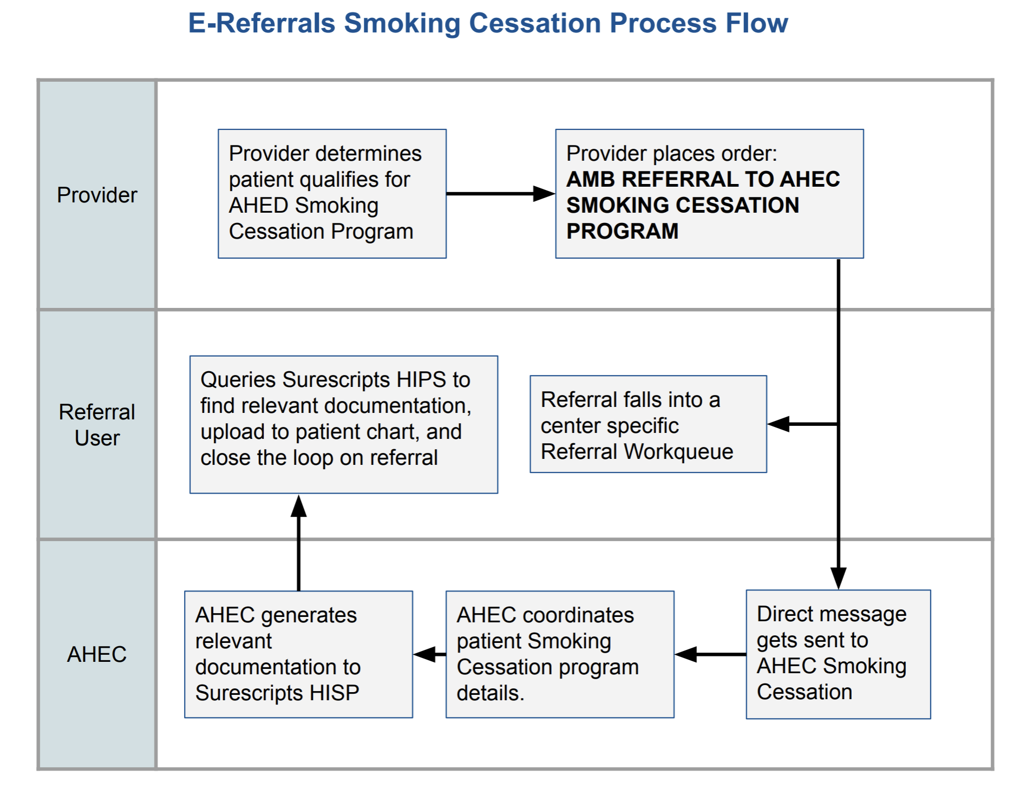
Bi-Directional e-Referral Process Flow
Health center places a referral →
The provider identifies a patient and submits a referral order in EPIC .
AHEC contacts the patient →
AHEC receives the referral through a secure messaging system (Surescripts HISP) and initiates contact with the patient to enroll them.
AHEC updates outcome →
After working with the patient, AHEC uploads a status update (e.g., completed, enrolled, declined).
Health center receives and closes a referral →
Referral users access the outcome report in EPIC, and formally close the referral

Slide 7
Uniform Data System (UDS)
  UDS Callout: This new AHEC referral pathway will not affect your UDS measures. To ensure your UDS measures for tobacco use are counted, your clinical support or provider will continue to document as they do today.

Slide 8

The Referral Workflow in EPIC (Health Center)
  How to Place the Order
  Review the Continuity Care Notes
  Manage the Referral
  Reviewing AHEC Report
  Close the loop

Slide 9
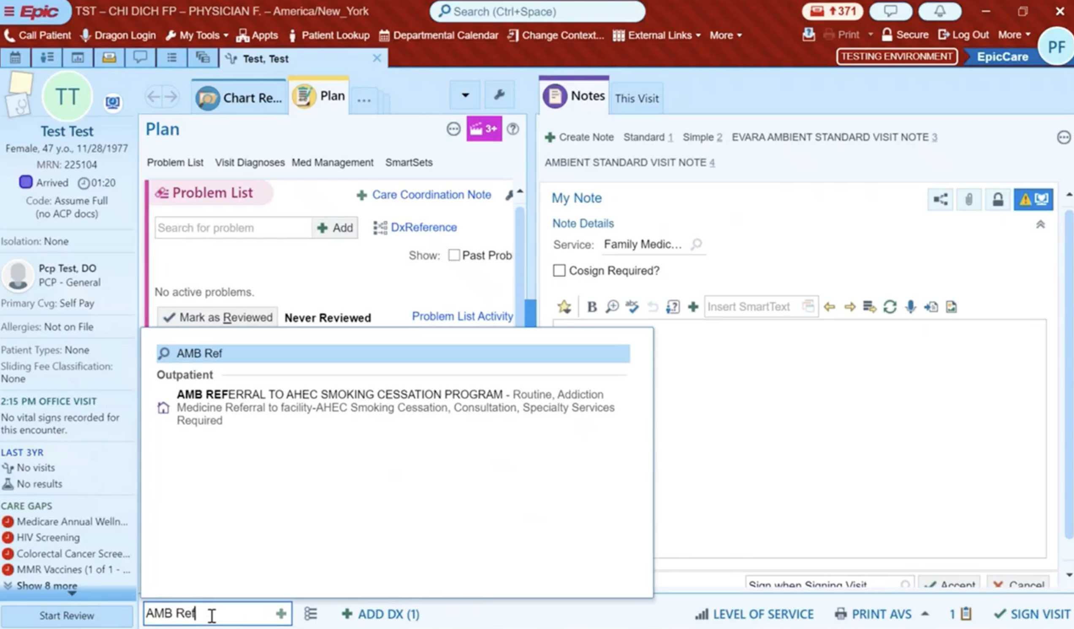
How to Place the Order - ✅ Step 1: Place the Referral Order
To place the order, navigate below your screen and click Add Order.

Slide 10
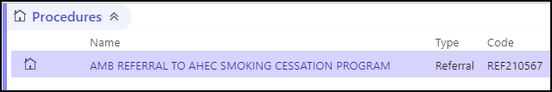
✅ Step 1: Place the Referral Order
Search for: AMB REFERRAL TO AHEC SMOKING CESSATION PROGRAM in EPIC.

Slide 11
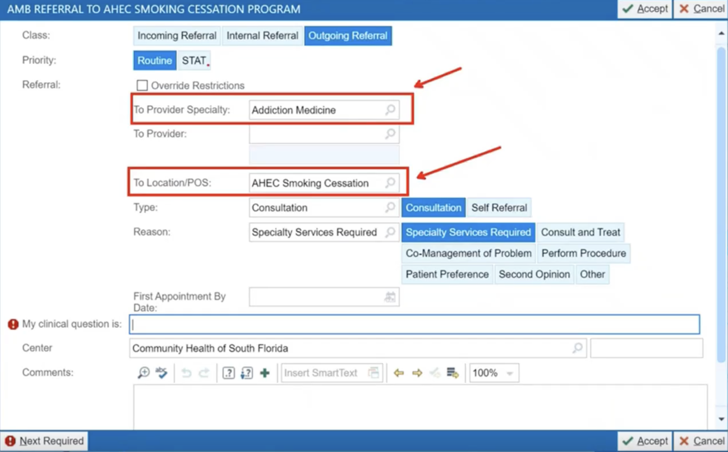
✅ Step 1: Place the Referral Order
Now the Order Composer will display:
  To Provider Specialty:
  Pre-populated with Addiction Medicine
  To Location/POS:
  Pre-populated with AHEC Smoking Cessation.
⚡ Important:
Do not change the Provider Specialty or Location.

Slide 12
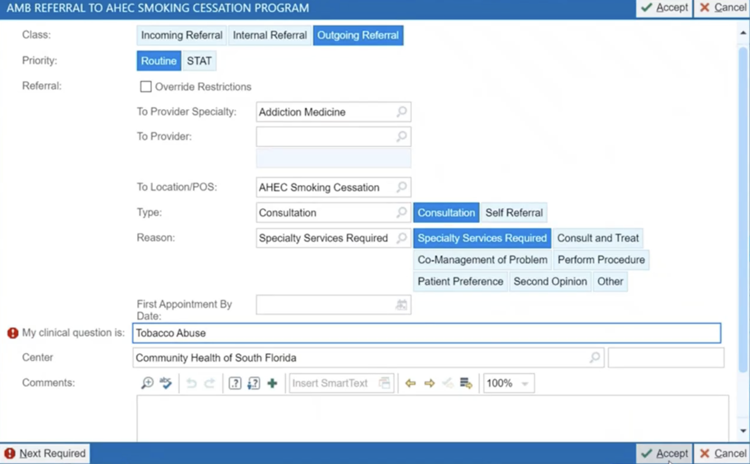
✅ Step 1: Place the Referral Order
Complete the required field: "My clinical question is".
Click Accept.

Slide 13
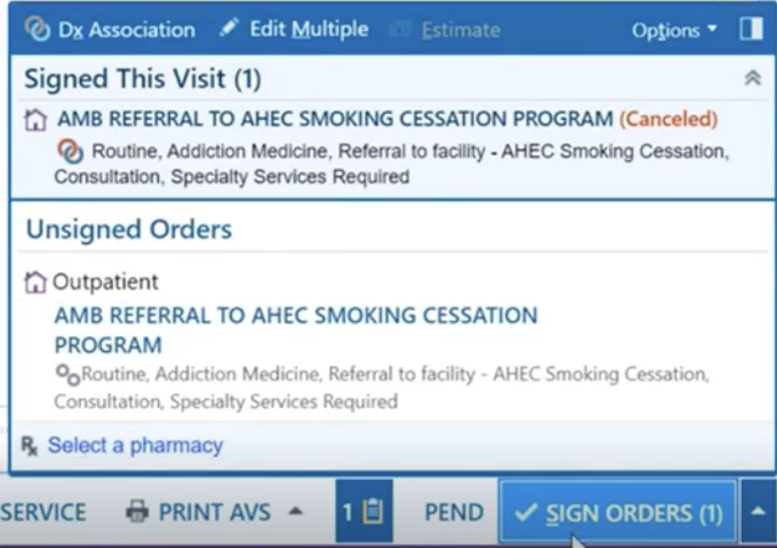
✅ Step 2: Sign the Order
Click Sign Orders to submit.

Slide 14
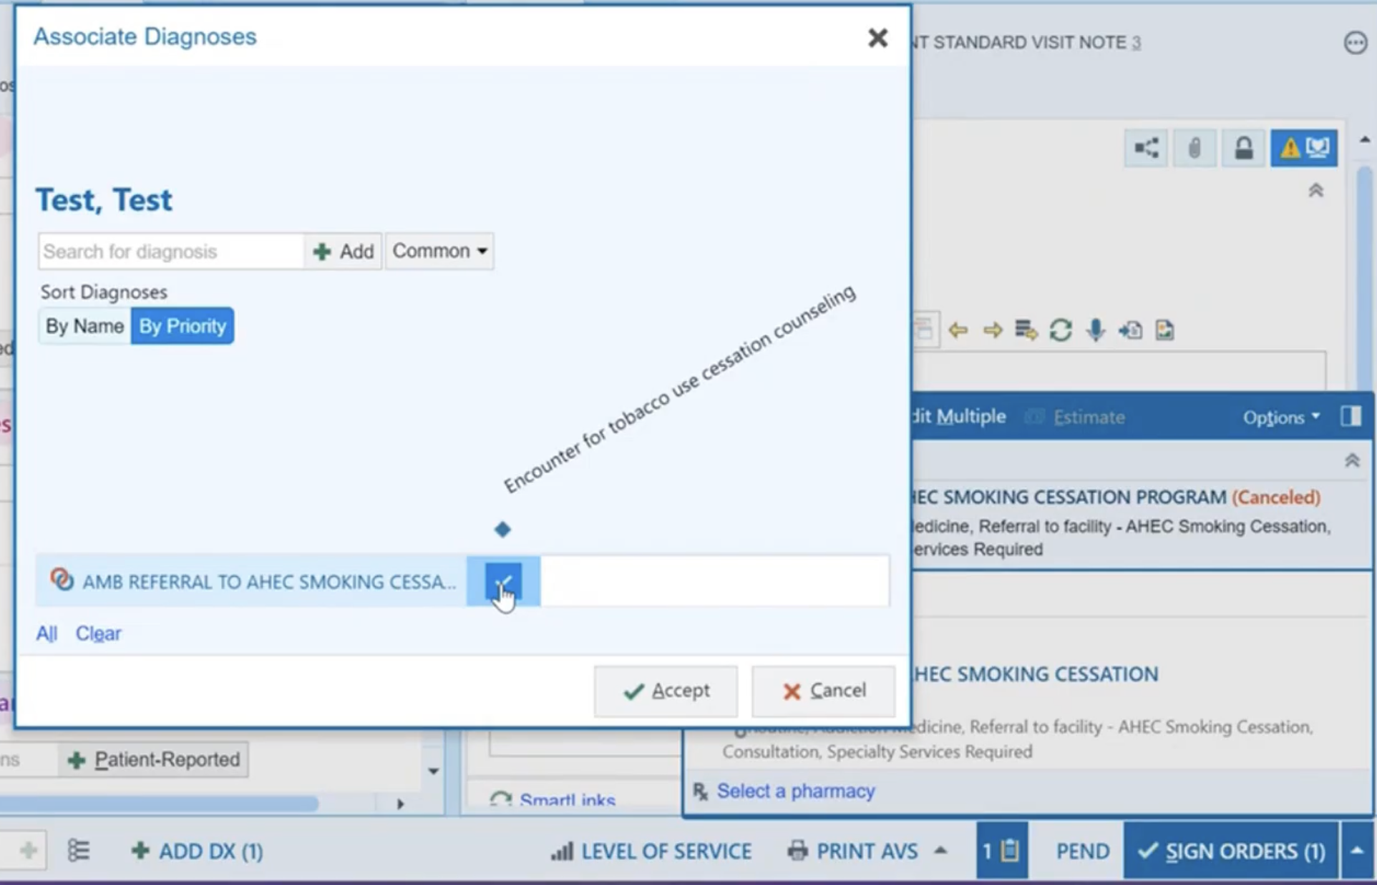
✅ Step 3: Associate a Diagnosis
Click on Search for Diagnosis and click the check box to link the diagnosis to the order.
Click Accept.

Slide 15
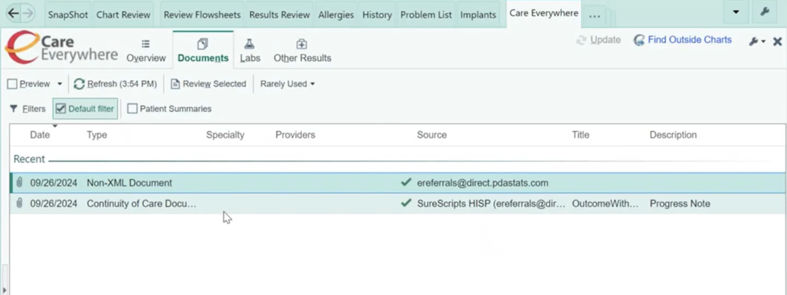
Review the Continuity of Care Notes
  Once the report with the outcome is sent back into EPIC, it will be filed in the patient's chart. To view the document, choose the Care Everywhere activity
  Select Documents and then select Continuity of Care Document

Slide 16
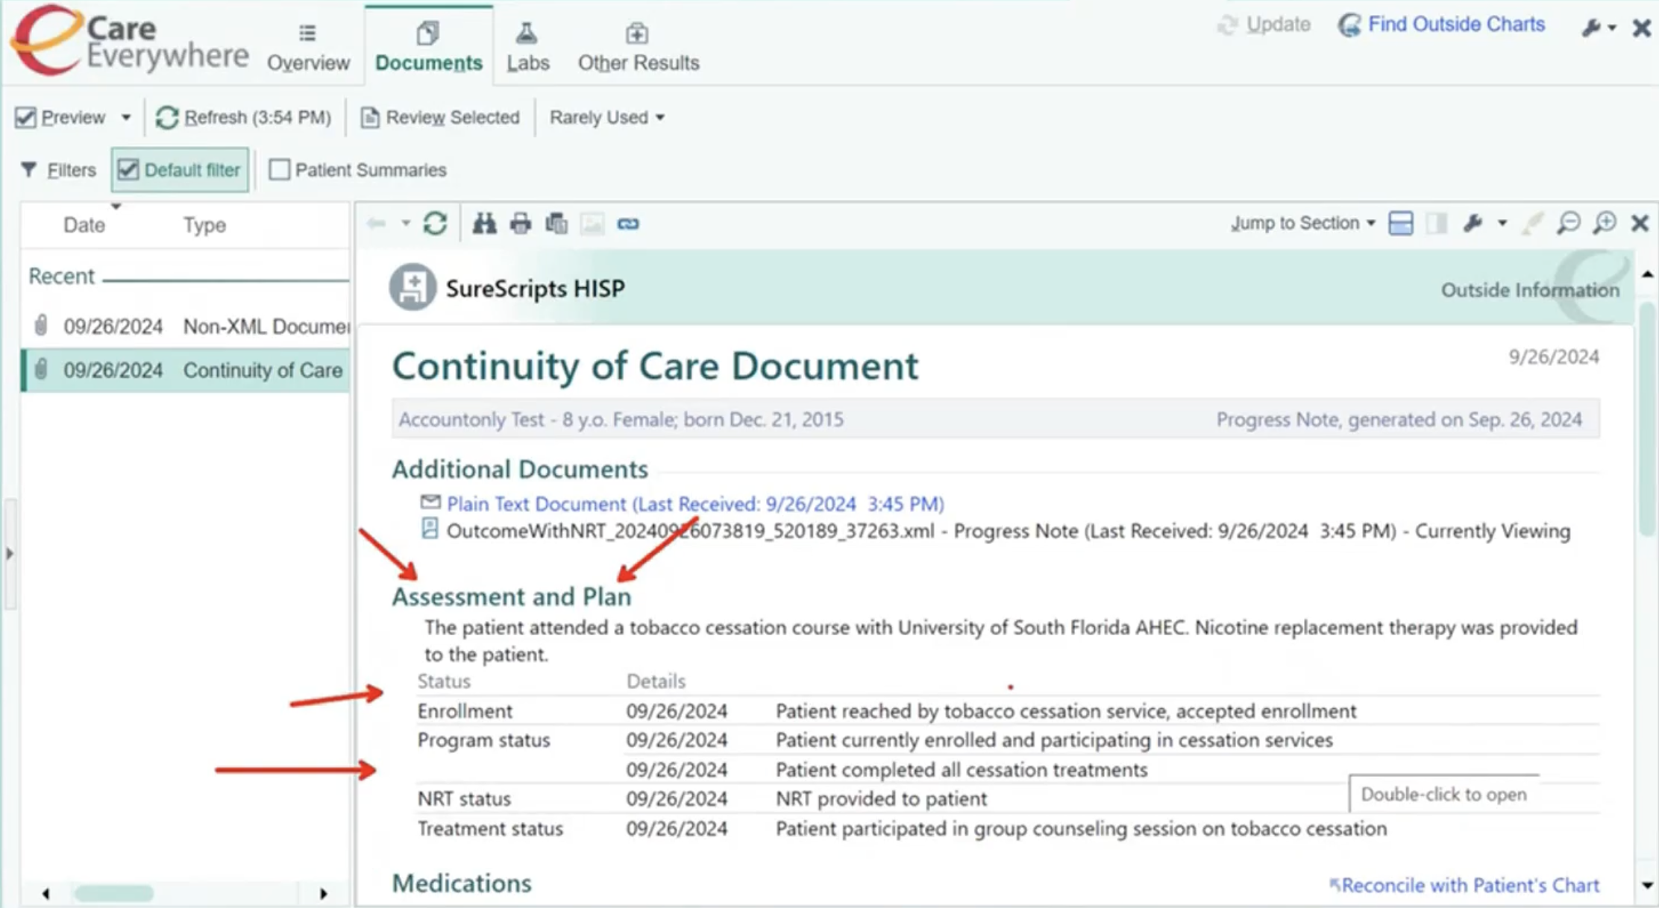
Review the Continuity of Care Notes
  All of the information will appear under Assessment and Plan.

Slide 17
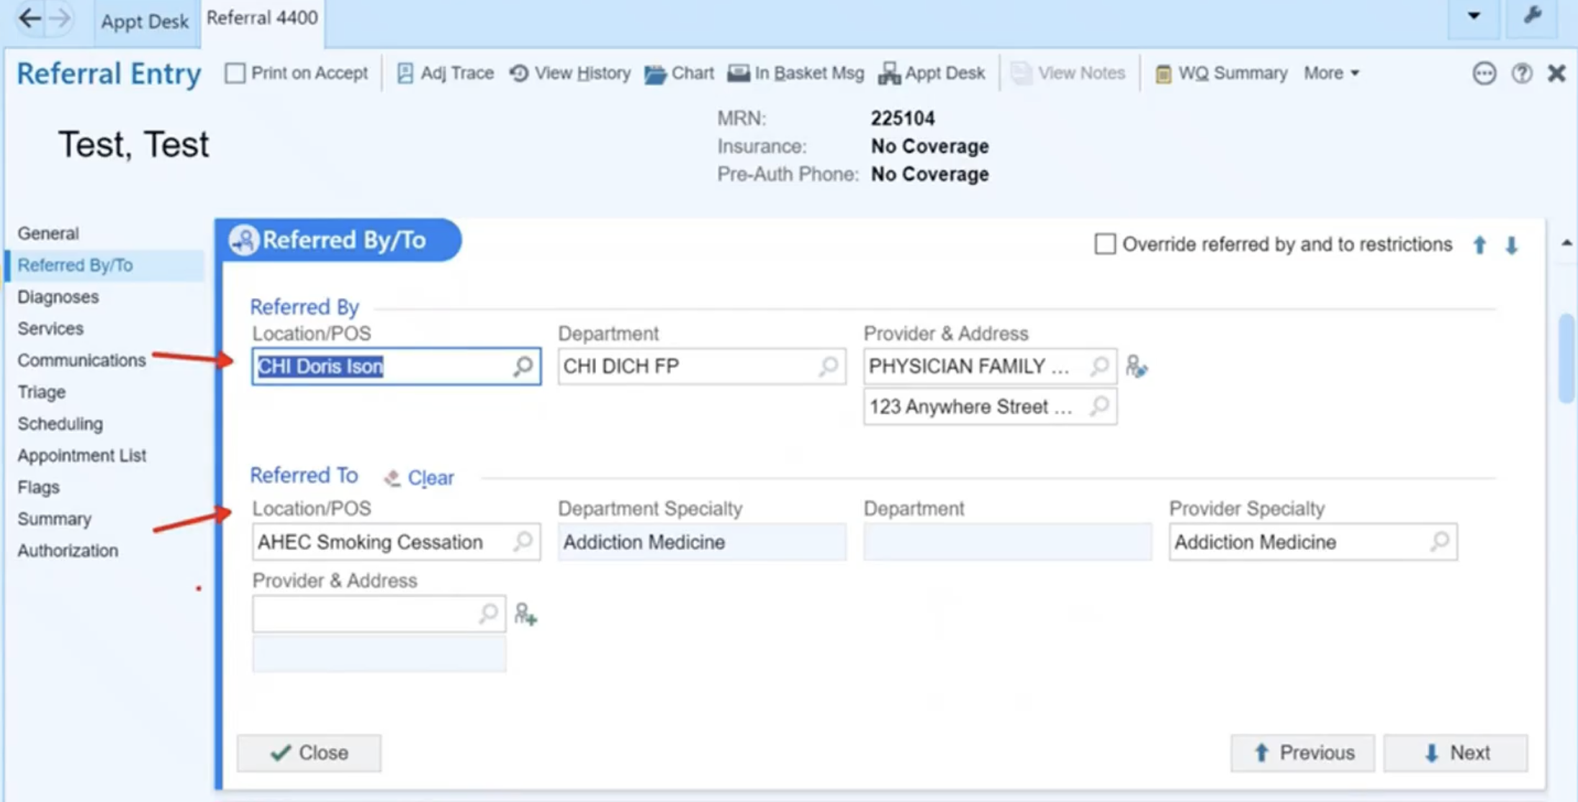
Managing the Referral
Once the order is signed, a referral will be generated from the ambulatory referral to AHEC Smoking Cessation program order. The referred by and referred to locations will be automatically populated from the order, as well as services and diagnoses.

Slide 18
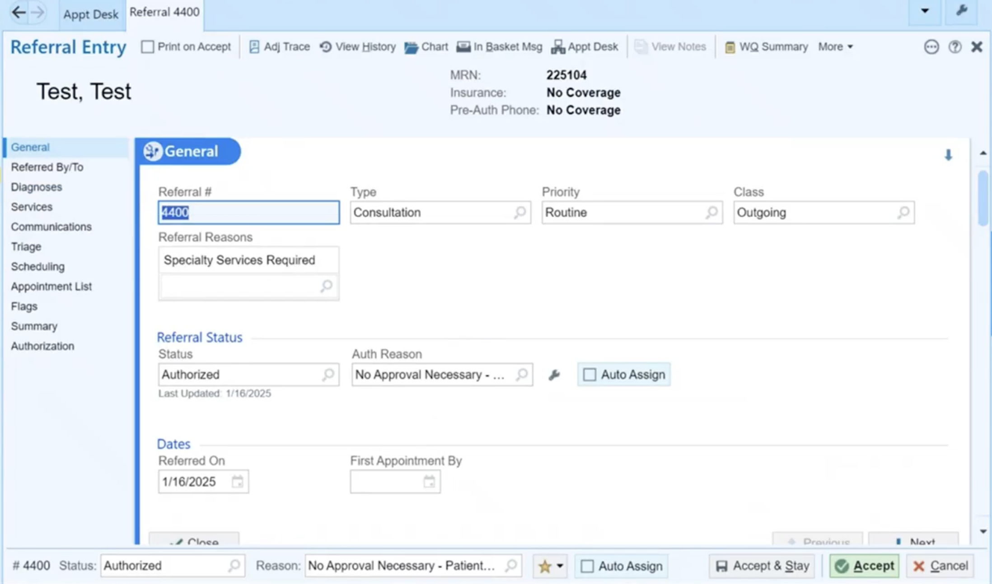
Managing the Referral
You can view Referral Status via the General section or the footer down below. The referral status will be indicated as authorized with a reason of no approval necessary.

Slide 19
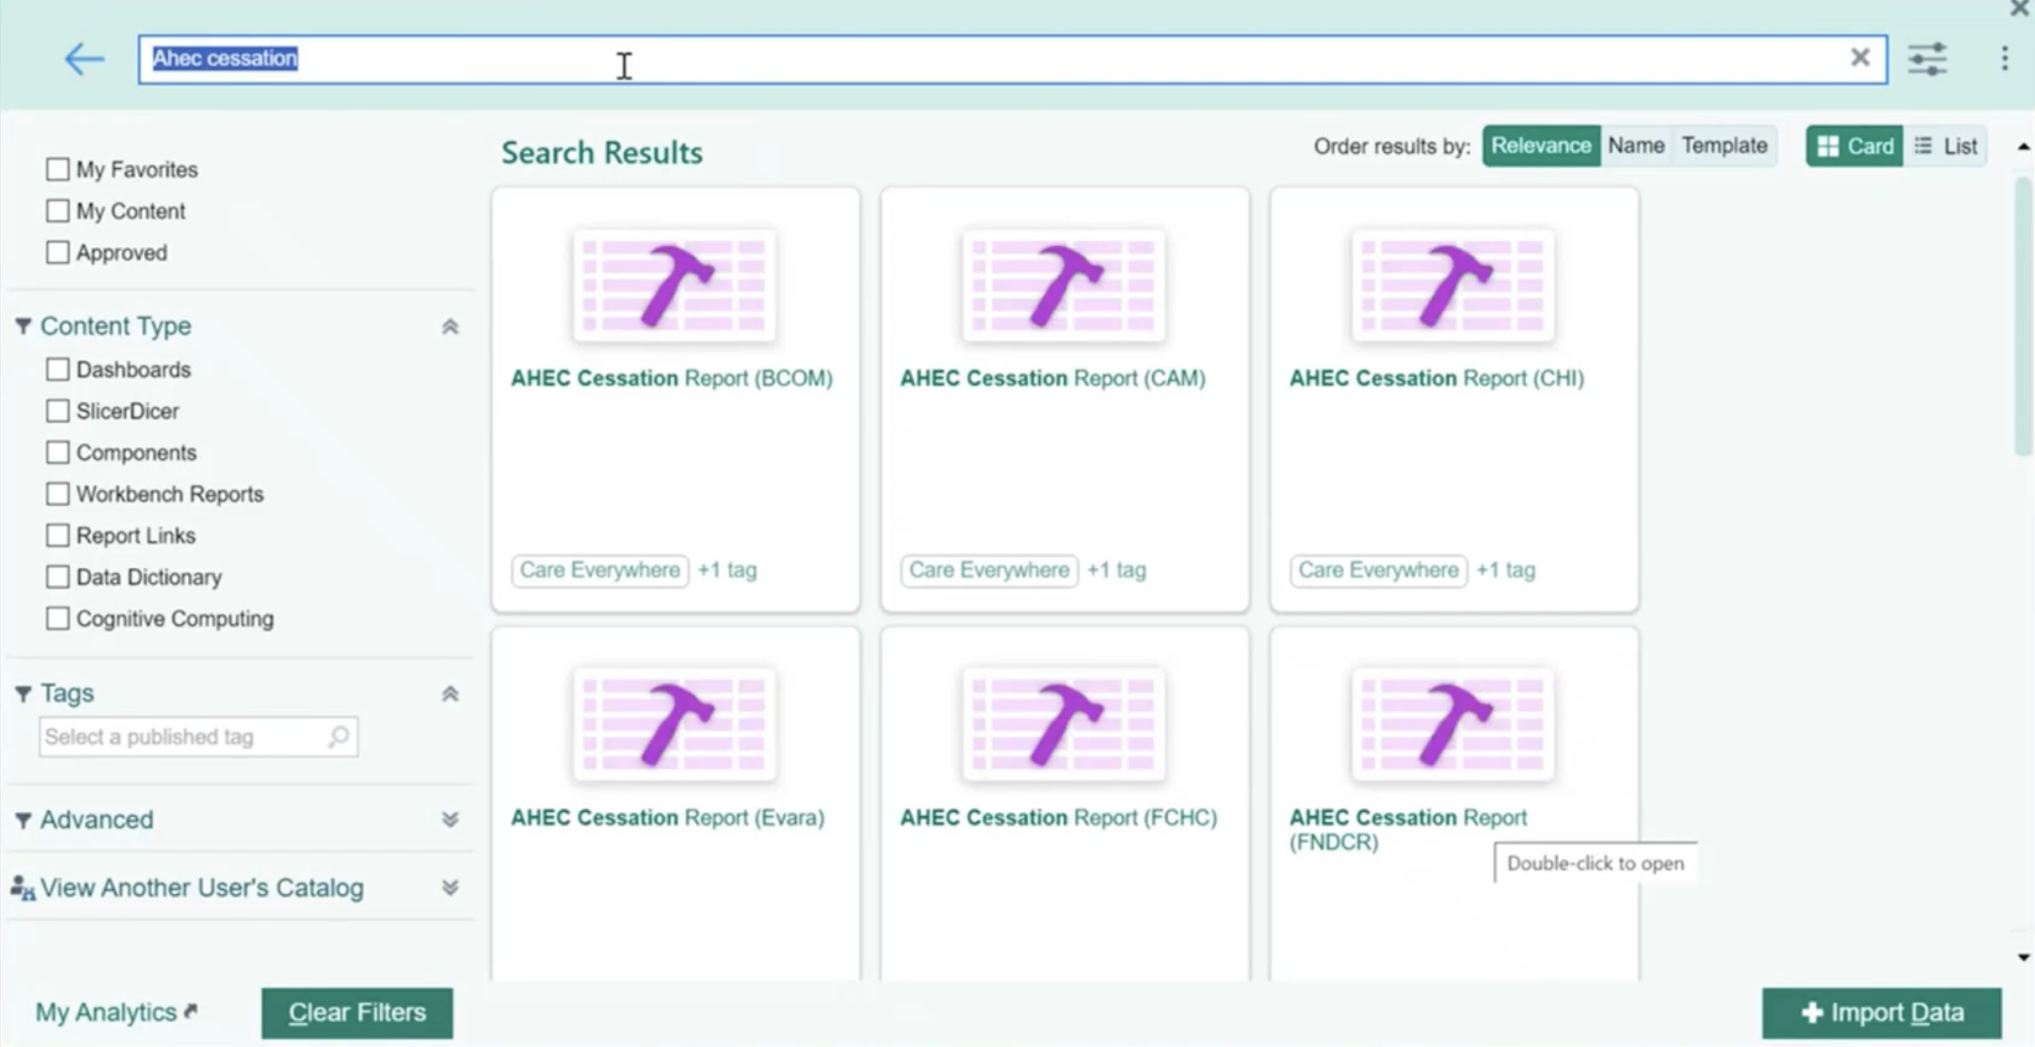
Reviewing the Report
When the patient has completed the program, AHEC will send back an incoming message, such as a continuity of care note. It will also be within an AHEC Cessation Report.
To view this report, navigate to your Analytics catalog. Search for AHEC Cessation Report. Once you've located your center's report, click Run.

Slide 20
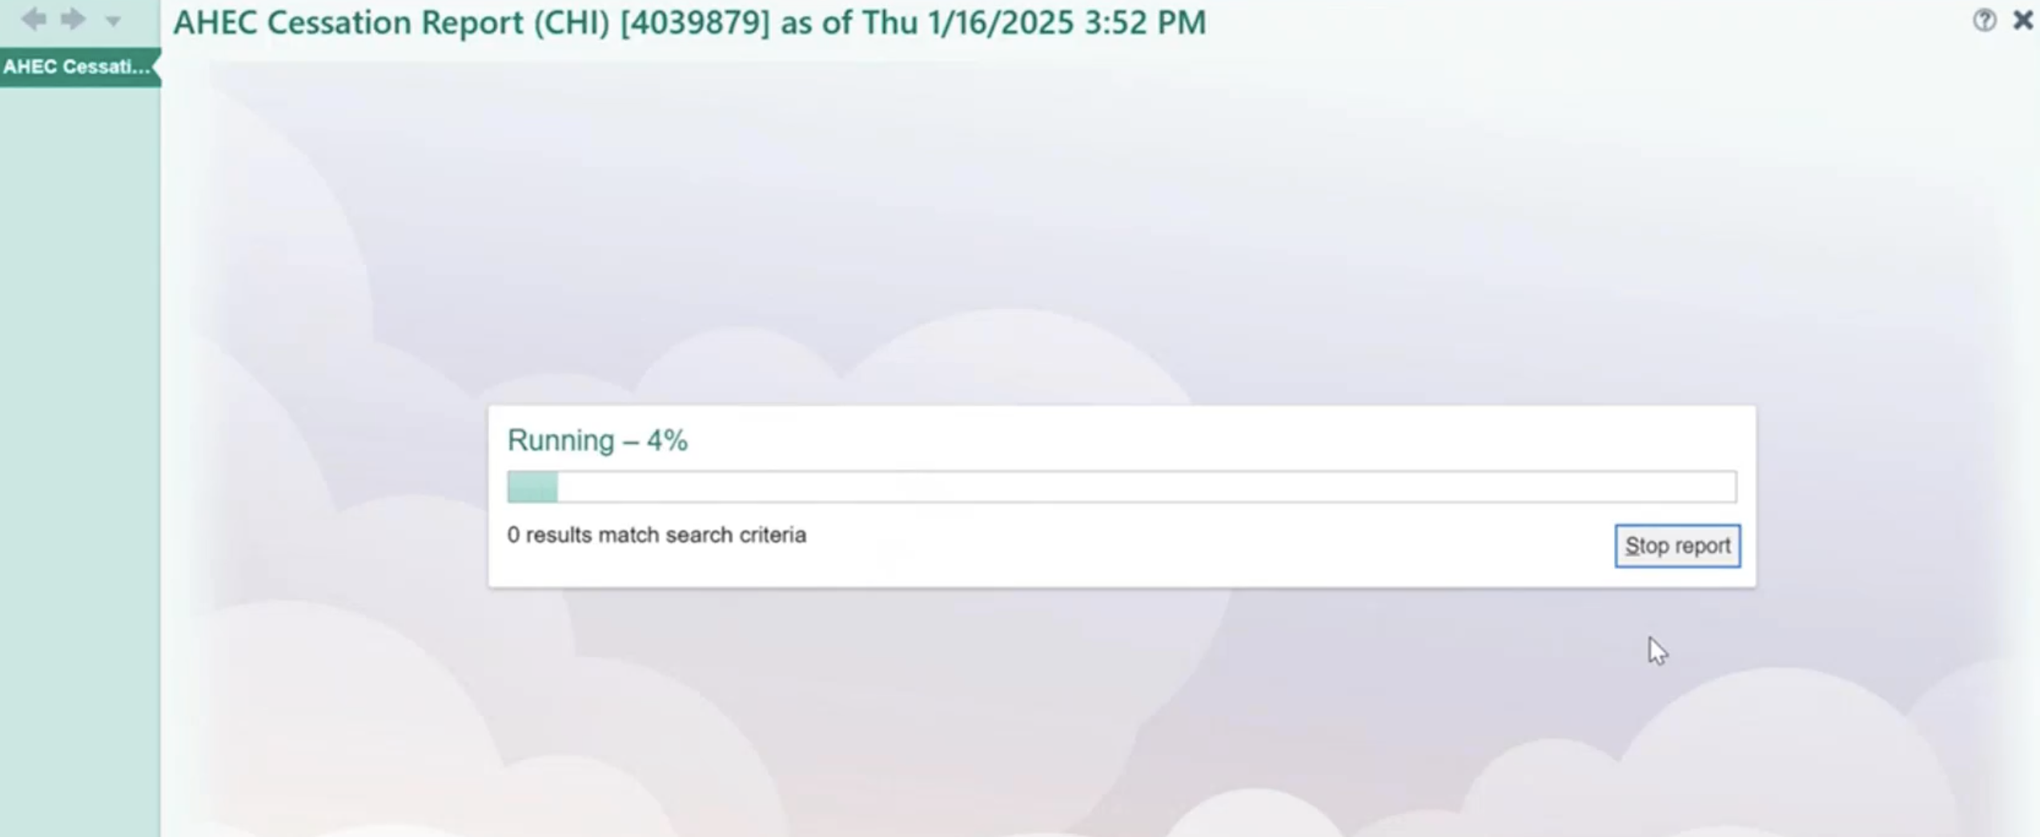
Reviewing the Report
This report will then populate all of the information you will need to view.

Slide 21
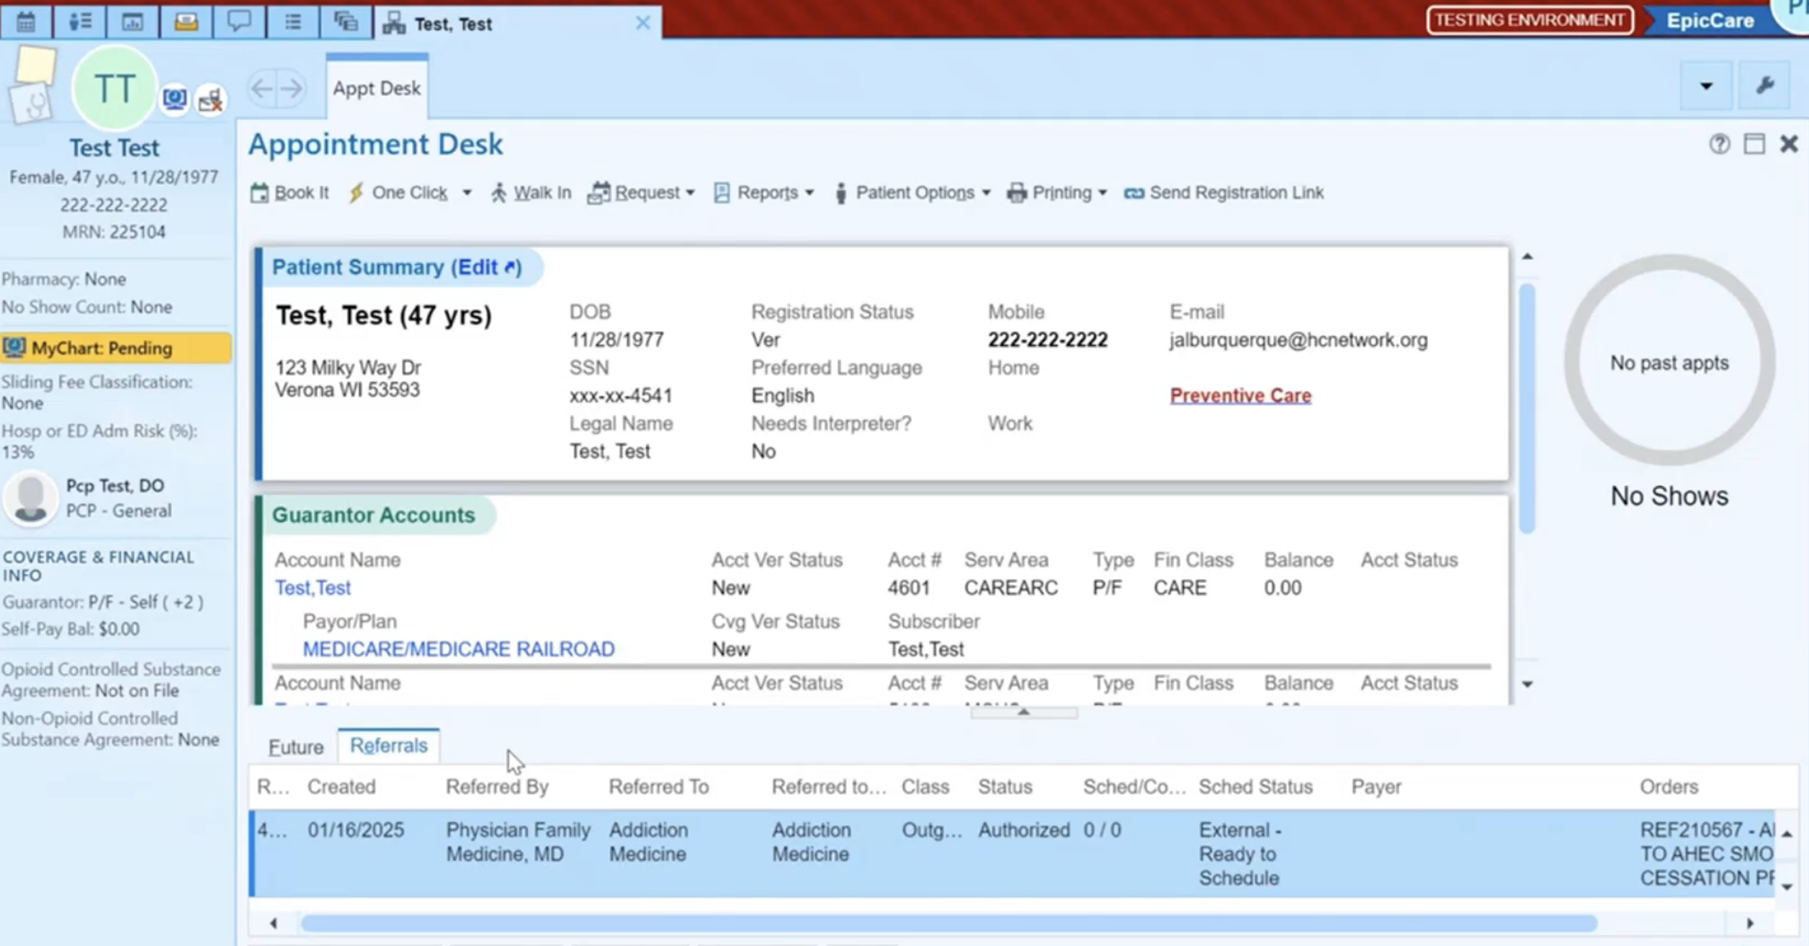
Close the Loop
After running the report, export each incoming message document to your center's appropriate folder. Navigate to the Patient Appointment desk, click on the Referrals tab, and click to open the referral associated with the AHEC Smoking Cessation program.

Slide 22
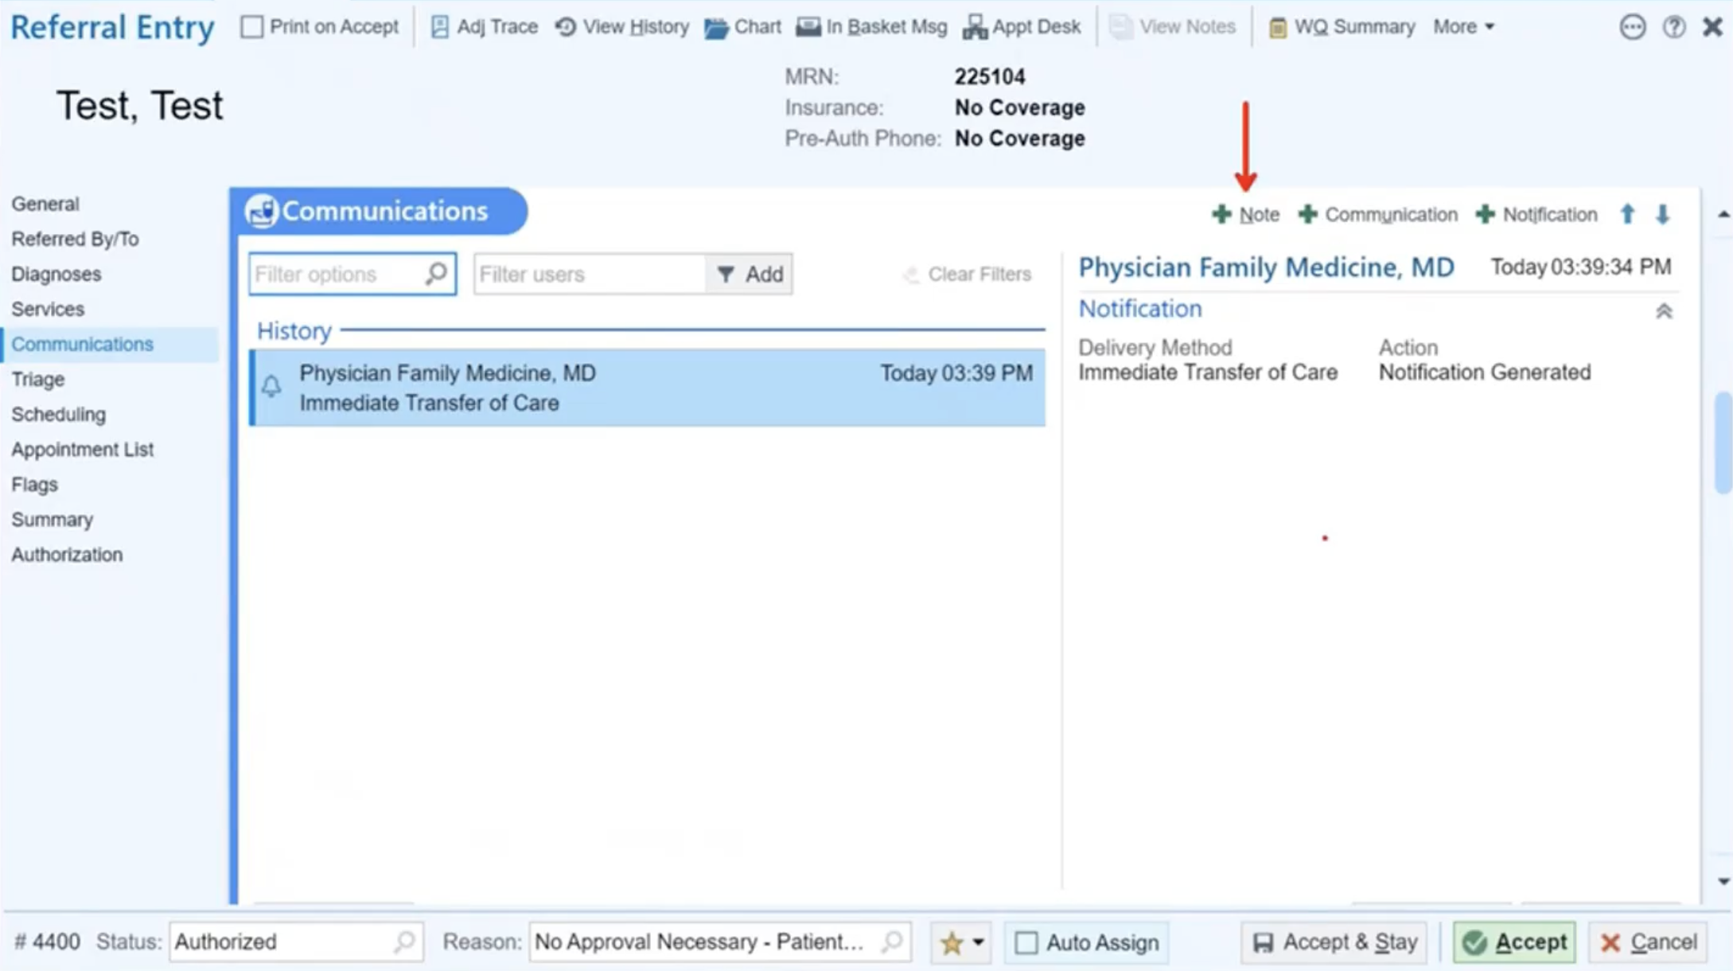
Close the Loop
Once you're in the patient's referral, open the Communications tab. Click on Note towards the top right of the Communications section.

Slide 23
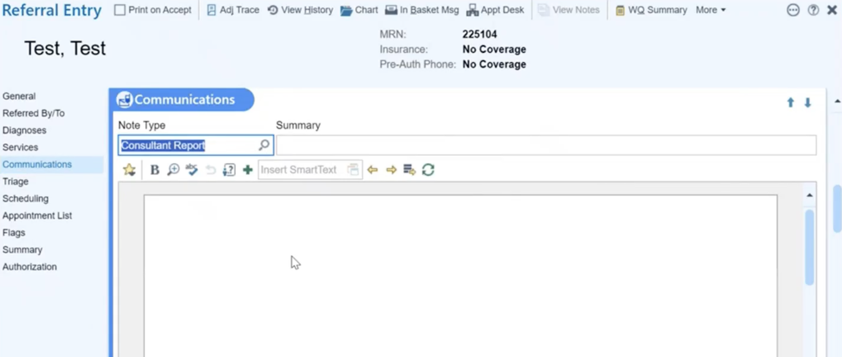
Close the Loop
Ensure that the note type is set to Consultant Report.

Slide 24
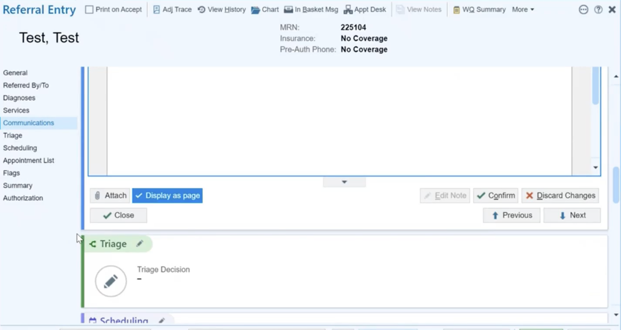
Close the Loop
Attach the incoming message to the referral note.

Slide 25
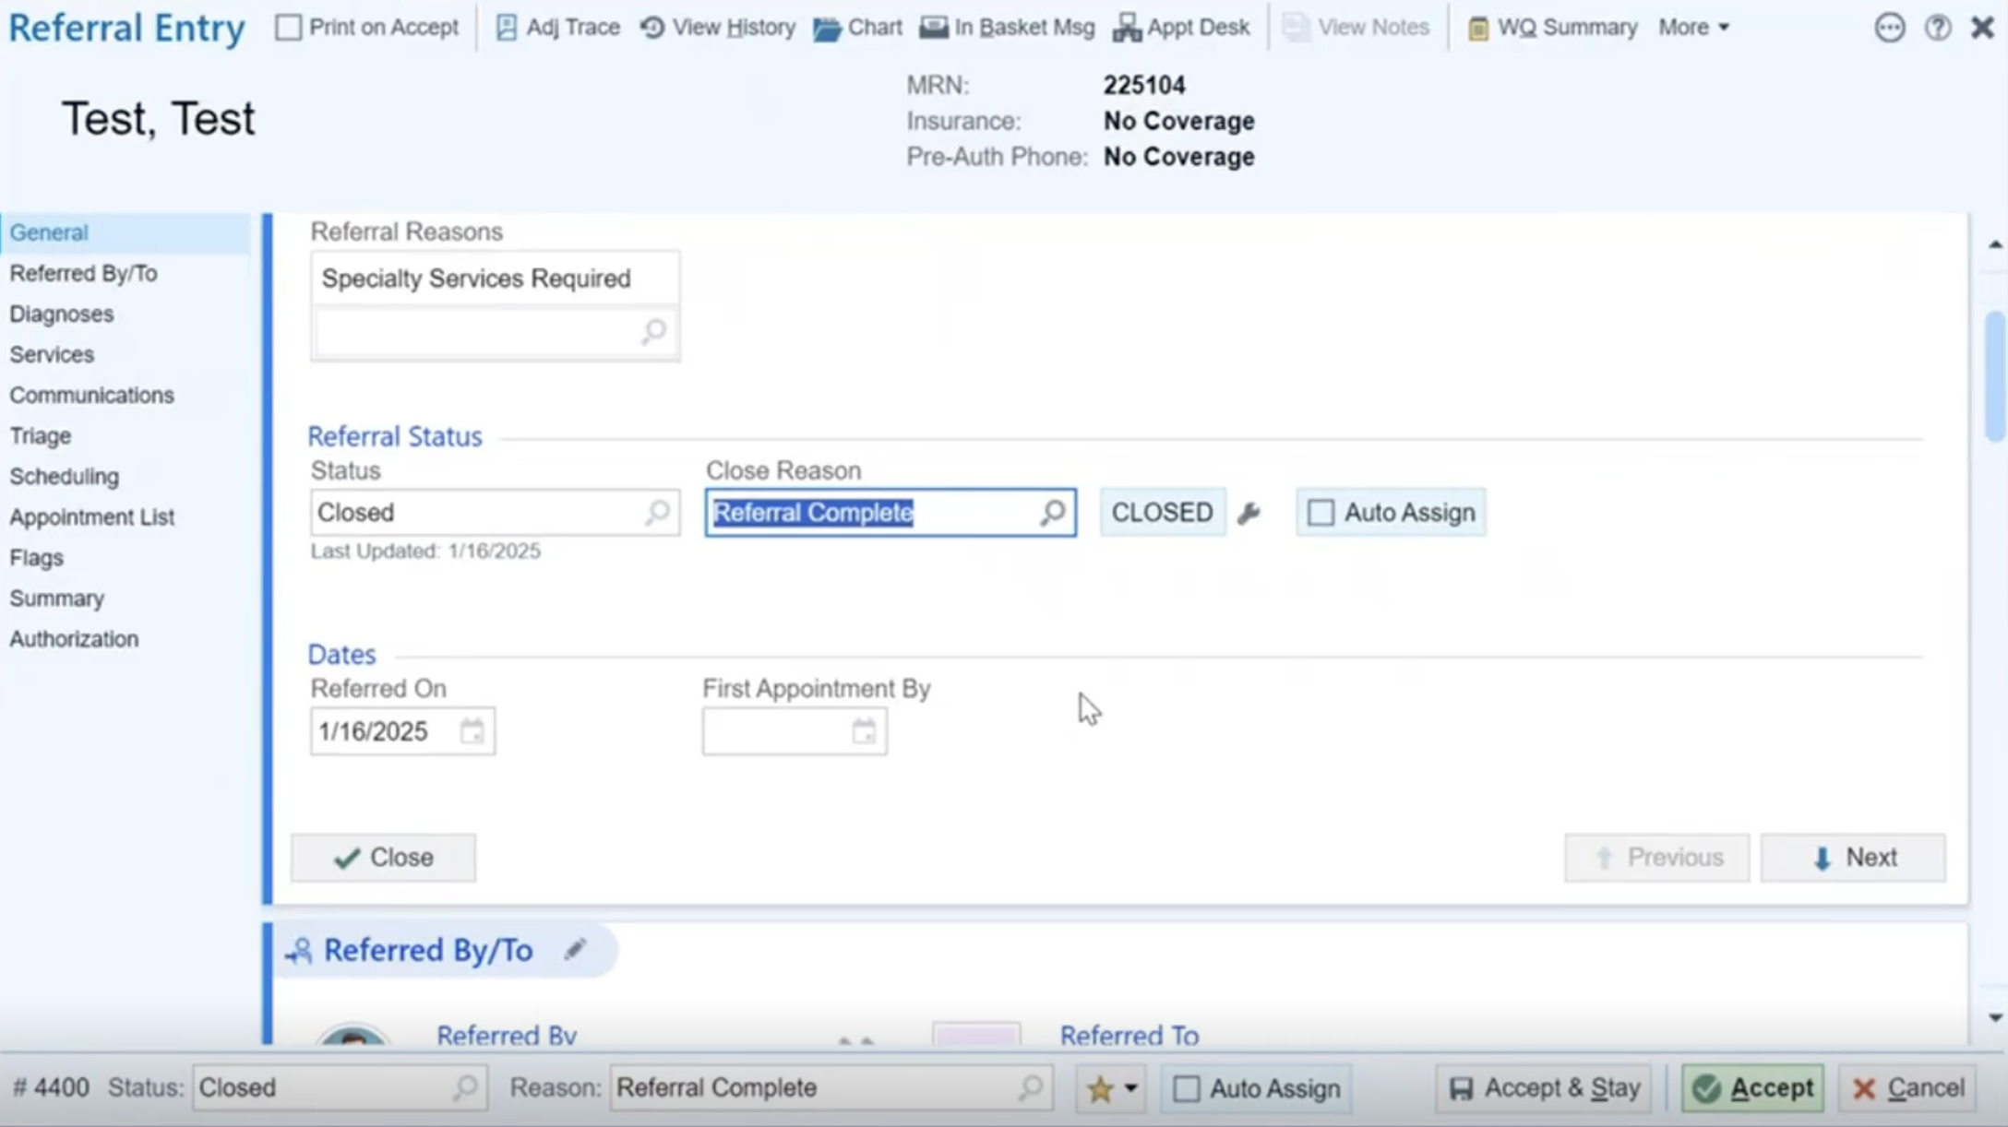
Close the Loop
Navigate to either the General section or the footer of the referral to update the status and reason.
Updating the referral status to Closed and reason to Referral Complete will effectively close the loop.
Click Accept

Slide 26
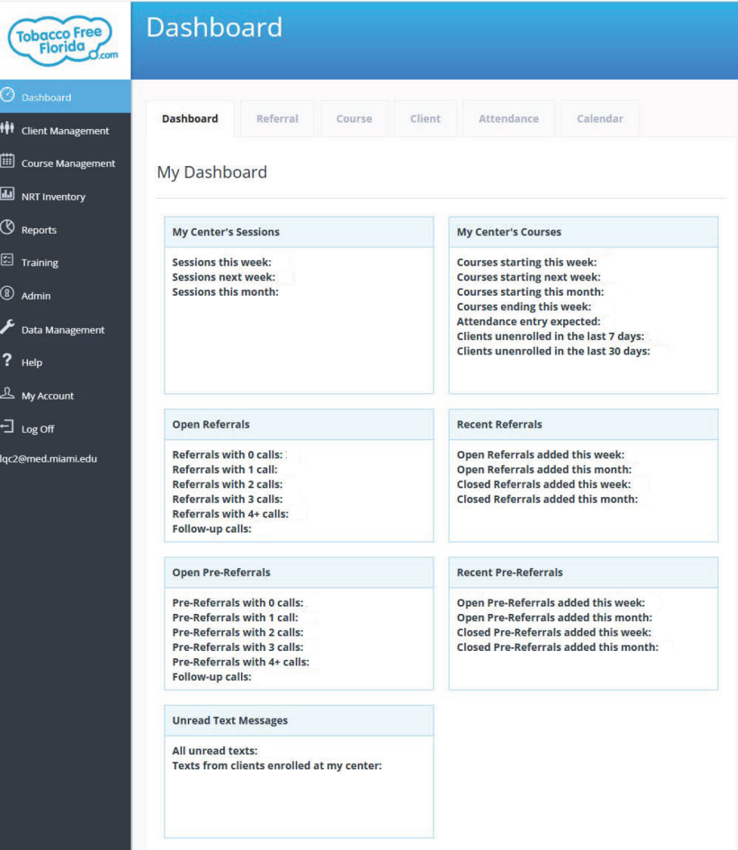
AHEC Dashboard: Managing Received Referrals
Dashboard Overview
AHEC teams view all referrals in the Tobacco Cessation Tracker (TFFACT) dashboard.
Open Pre-Referrals
Click Pre-Referrals with 0 calls to view the new referrals received for the day.

Slide 27
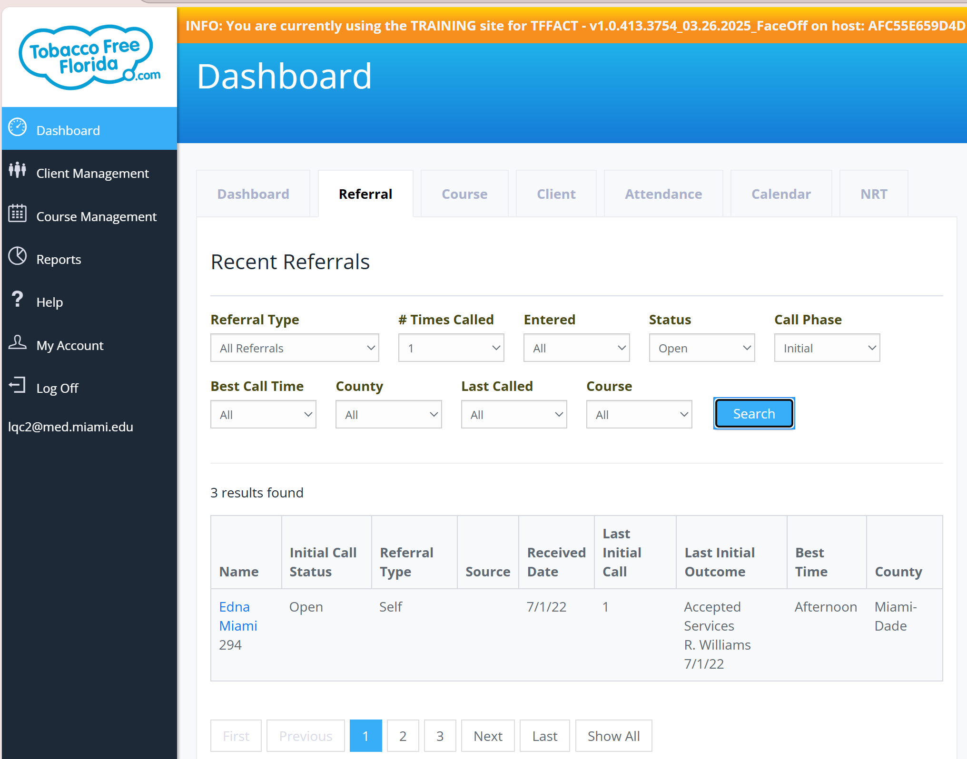
AHEC Dashboard: Select Referrals
Referral Management
You will be directed to view all new patient referrals
Select the new patient referral to view client profile

Slide 28
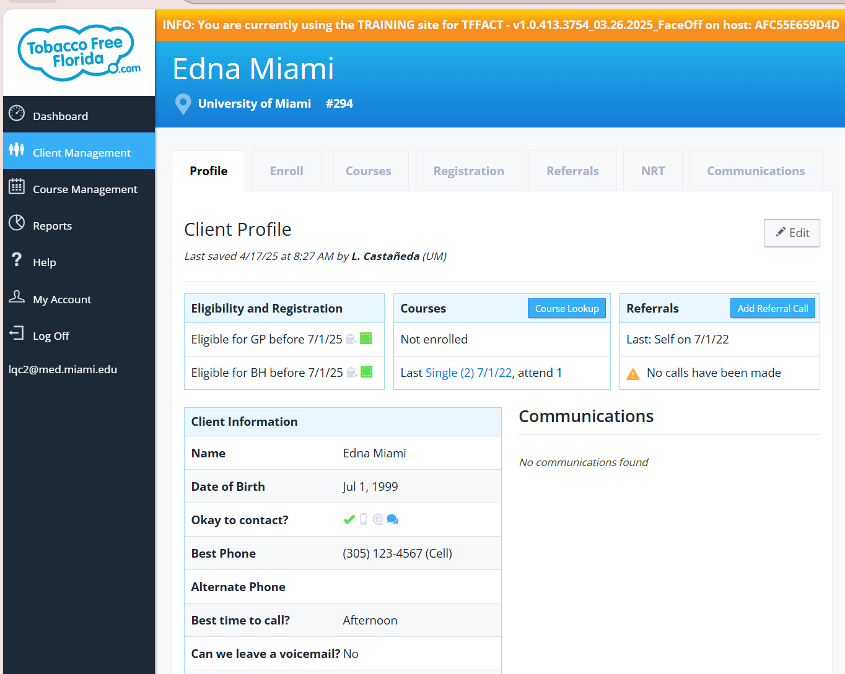
AHEC Dashboard: View Patient Profile
Client Profile View
Patient information displayed (name, contact, address, smoking status, date of referral).
Referral notes and progress tracking are visible.
Referral Detail View
Navigate to Referrals tab under Client Management

Slide 29
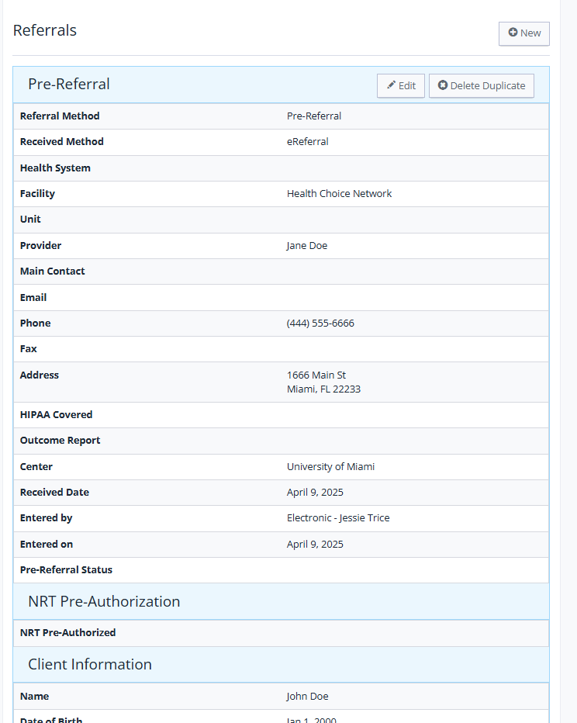
AHEC Dashboard: Edit Patient Status
Edit Patient Status
Scroll all the way down and click Edit on the bottom right corner to open the referral edit page
*Health system field is currently not showing center name – Epic team is actively working on a solution. To find out which health center the referral is from, you can look up the address of the referral to locate the center.

Slide 30
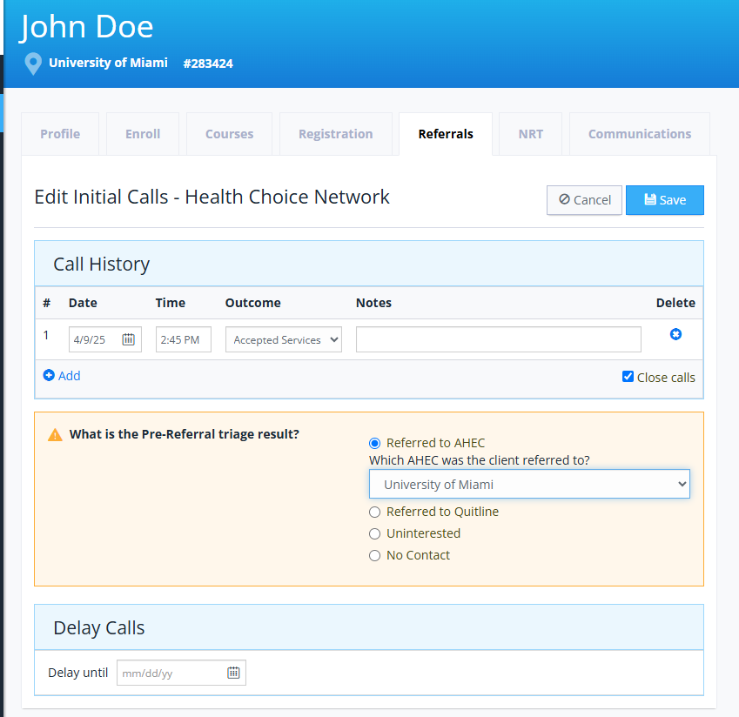
AHEC Dashboard: Edit Patient Staus
Update Outreach Outcome
AHEC officers document outreach outcomes:
  Enrollment
  Declined services
  Completed cessation program
Update Pre-Referral triage result to appropriate status
  Fill in the AHEC location the client was referred to
Click Save
Feedback to Health Centers
Updates are recorded and later sent back to the clinic via Continuity of Care documents.

Slide 31
Key Reminders
Check the Dashboard Regularly
Monitor the Tobacco Cessation Tracker (TFFACT) daily for new incoming referrals.
Initiate Patient Contact Promptly
Attempt to reach referred patients quickly to maintain engagement and motivation.
Document Patient Outcomes Clearly
Record patient interactions accurately:
  Enrolled, declined, or completed cessation counseling
Update Status in the Tracker
Ensure the patient's profile is updated to reflect their most recent status.
Prepare and Send Outcome Reports
Finalize Continuity of Care Documents for patients who complete (or decline) services.
Ensure reports are sent back securely through the correct channels (Surescripts HISP to EPIC).
Close the Loop
Timely feedback to the health center team is critical to close the referral and meet project reporting goals.

Slide 32
Thank you!
Veronica Zhang Paley, MS, MPP
  Research Coordinator
  vzhangpaley@hcnetwork.org
Edelise Y. Endemano
  Research Operations Manager
  EEndemano@HCNetwork.org
Katherine Chung-Bridges, MD, MPH
  Chief Community Research Officer
  kchung@hcnetwork.org

